Slide 1

Credit Card Fraud Detection

Slide 2
Background
The data was pulled from credit card transactions made in September 2013 by European card holders.
The data has variables V1-V28, Time, Amount, and Class.
According to the data set description V1- V28 had confidential names so the got changed.
Time is the seconds between the transactions in the data set starting with the first transaction.
Amount is the transaction amount.
Class has a value of 1 for fraudulent transaction and 0 for normal transaction.

Slide 3
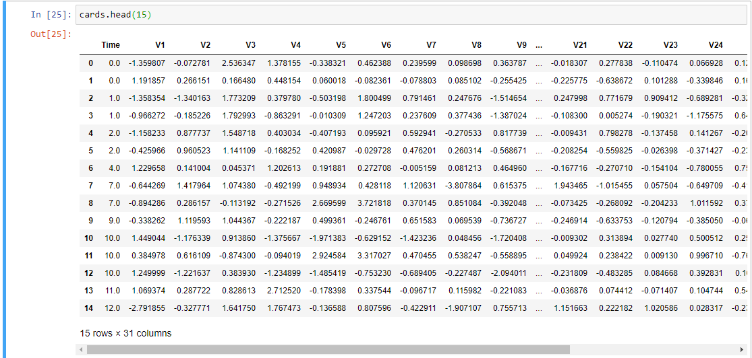

Slide 4
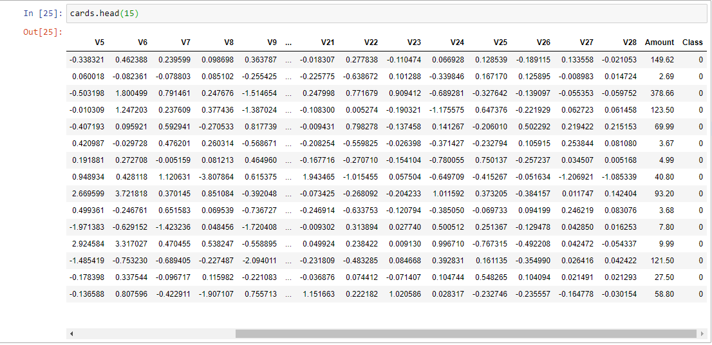

Slide 5
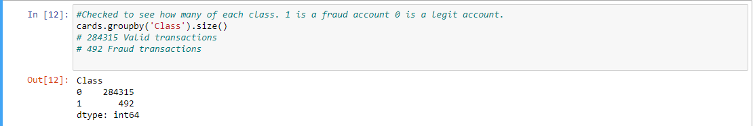
Analysis
In the data set there are 284,807 total transactions
There are 284,315 real transactions
Along with 492 fraudulent transactions

Slide 6
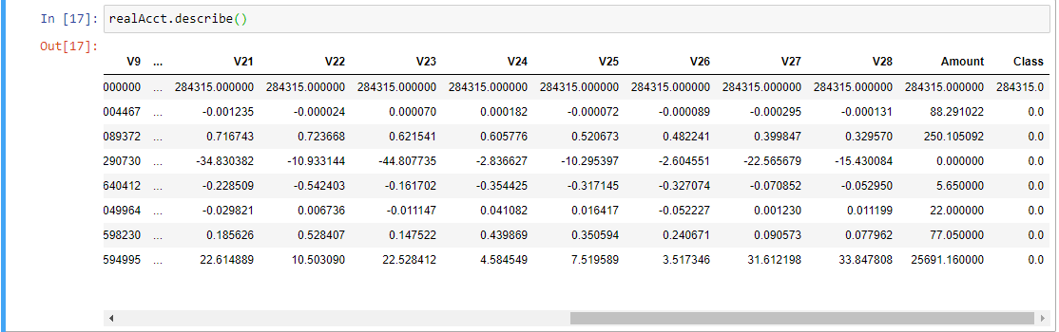
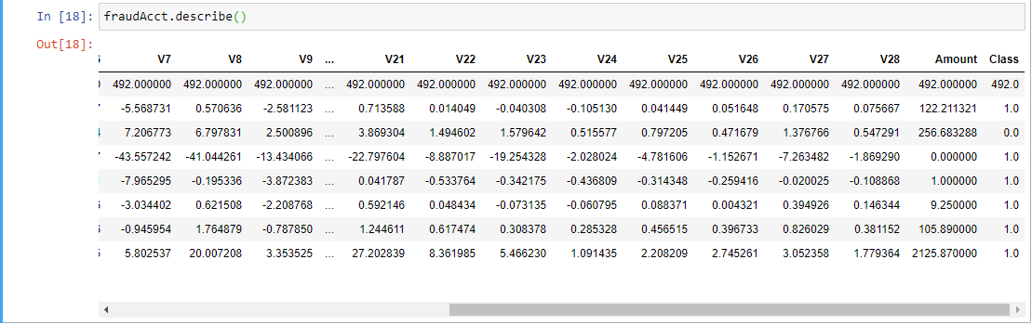
Analysis
The average amount of a real transaction was $88.
The average fraud transaction was $122

Slide 7
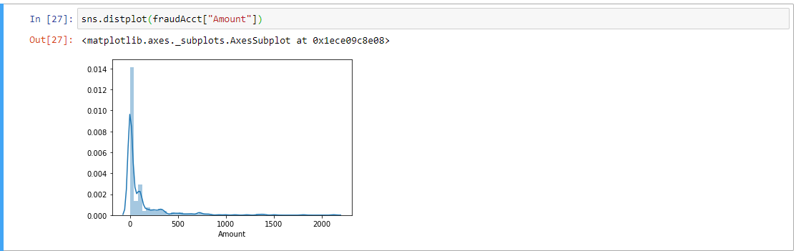

Slide 8
Random Forest Classifier
I used a random forest classifier to predict the accuracy of the model picking authentic transactions
I split the data into a 70% training and 30% test split to evaluate the data
Using the RFC I was looking for the accuracy score, precision, and recall score
Accuracy score measures how many labels the model got right out of the total number of predictions.
Precision score is the number of correctly-identified members of a class divided by all the times the model predicted that class
Recall is the number of members of a class that the classifier identified correctly divided by the total number of members in that class.

Slide 9
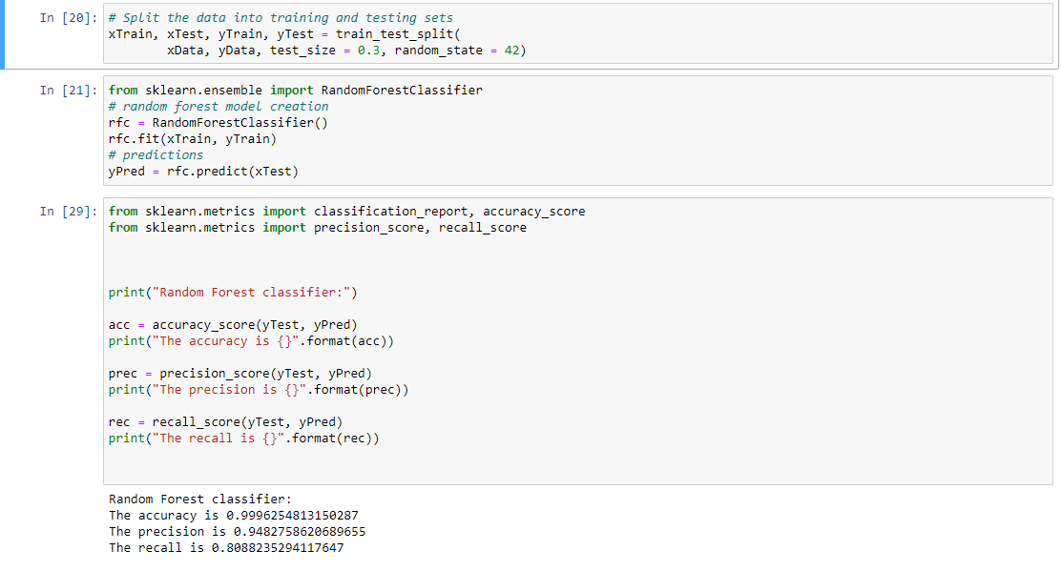

Slide 10
RFC Results
The accuracy of the model is 0.999 (Since the data set is extremely unbalanced this should not be used as measure of model performance)
The precision is 0.948
The recall is 0.808

